Slide 1



SESSION 1 : Briefing About R and RStudio

Slide 2
R Programming Language
R is a language and environment for statistical computing and graphics. It is a GNU project which was developed at Bell Laboratories (formerly AT&T, now Lucent Technologies) by John Chambers and colleagues.
R provides a wide variety of statistical (linear and nonlinear modelling, classical statistical tests, time-series analysis, classification, clustering, …) and graphical techniques, and is highly extensible.
https://cran.r-project.org/
Current R version : R-4.1.1
R (Integrated Suite of Software facilities)
Effective data handling and storage facility
A suite of operators for calculations on arrays and matrices
Graphical facilities for data analysis
A large, coherent, integrated collection of intermediate tools for data analysis
Includes conditionals, loops, user-defined recursive functions & input and output facilities.

Slide 3
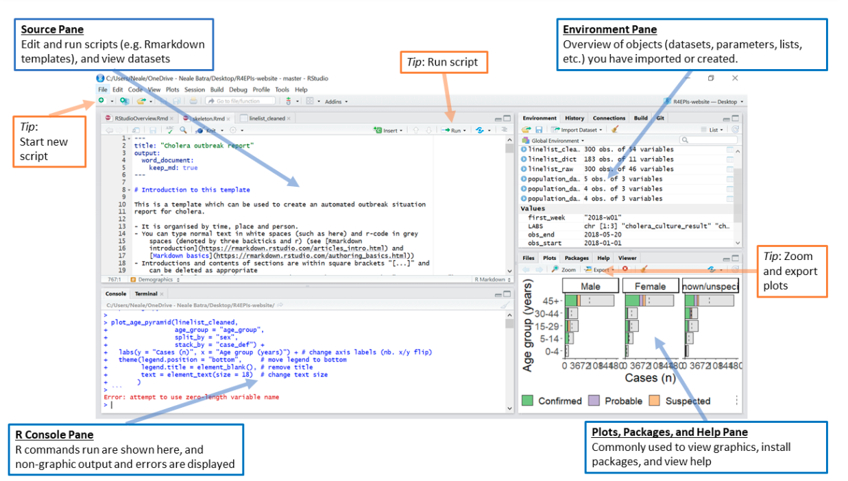
RStudio
RStudio is an Integrated Development Environment (IDE) for R, a programming language for statistical computing and graphics.
Unlike many other statistical software packages in which a graphical user interface is employed, a typical user interacts with R primarily through the command line.
An IDE for R include a means for issuing commands interactively.

Slide 4
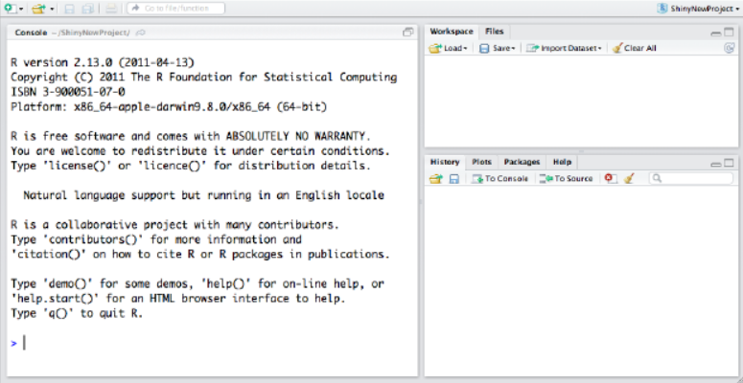
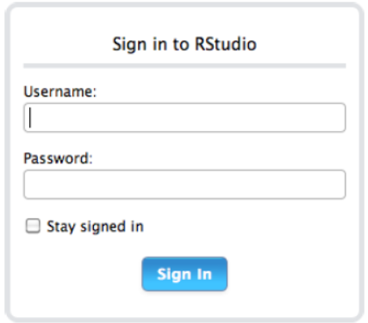
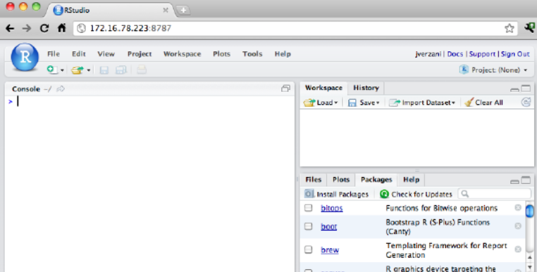
Why RStudio
Easier and more productive to use R
4-panel layout
That includes a console for interactive R sessions,
A tabbed source-code editor to organize a project’s files, and
Panels with notebooks to organize less central components.
Source-code editor is feature-rich
Setting up different projects is a snap, and switching between them is even easier.
Easy-to-use administrative tools for managing packages, the workspace, files, and more.
DESKTOP
SERVER
Console, Workspace, History
Enables you to provide a browser based interface to a version of R running on a remote Linux server,
Mac: Icon in App, Windows: Desktop, Linux: rstudio command

Slide 5
RStudio
R is not unique in this respect, and IDEs for interactive scientific programming languages have matured to include features such as:
CONSOLE
SOURCE CODE EDITOR
OBJECT BROWSER
Development involves the act of programming & this task is inevitably done with a source-code editor.
An object browser allows the user to identify quickly the type and values for each such variable.
A console for issuing commands.
OBJECT EDITOR
DOC INTEGRATION
PLOT MANAGEMENT
A means to inspect or edit objects is typically provided
We can see the documentation
We can manage
the plotting

Slide 6
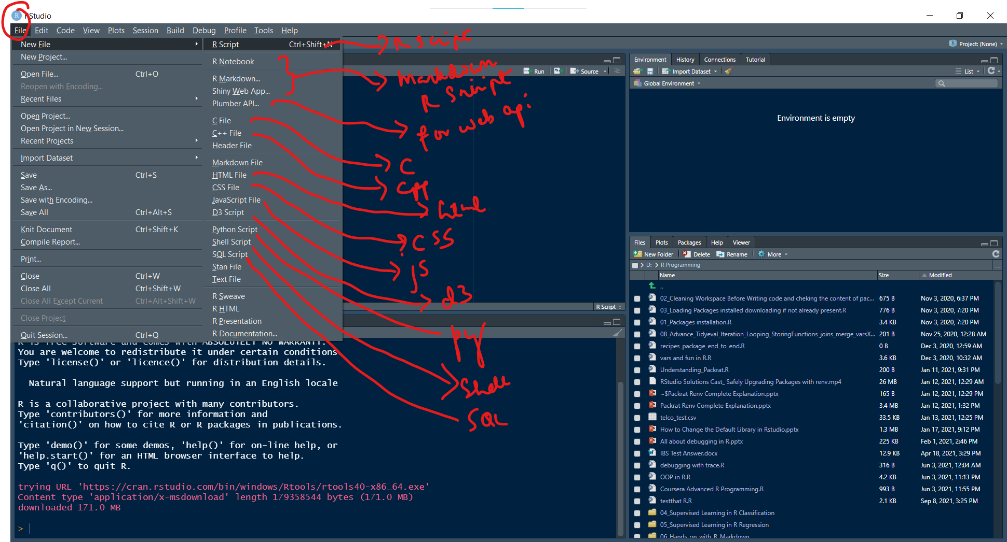
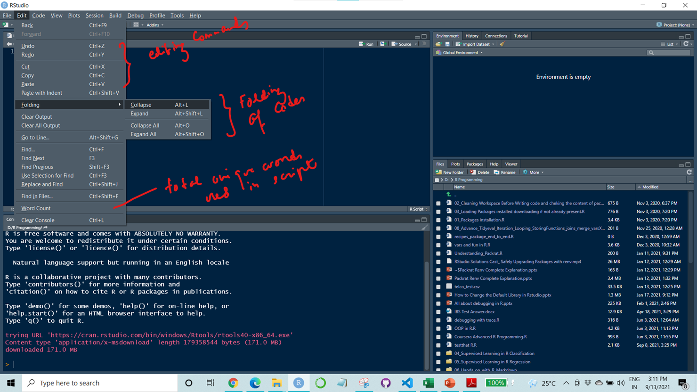
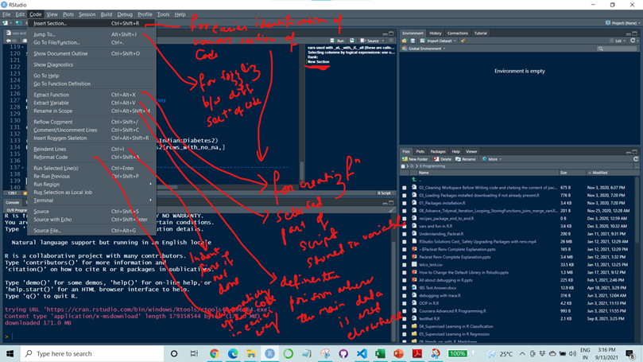
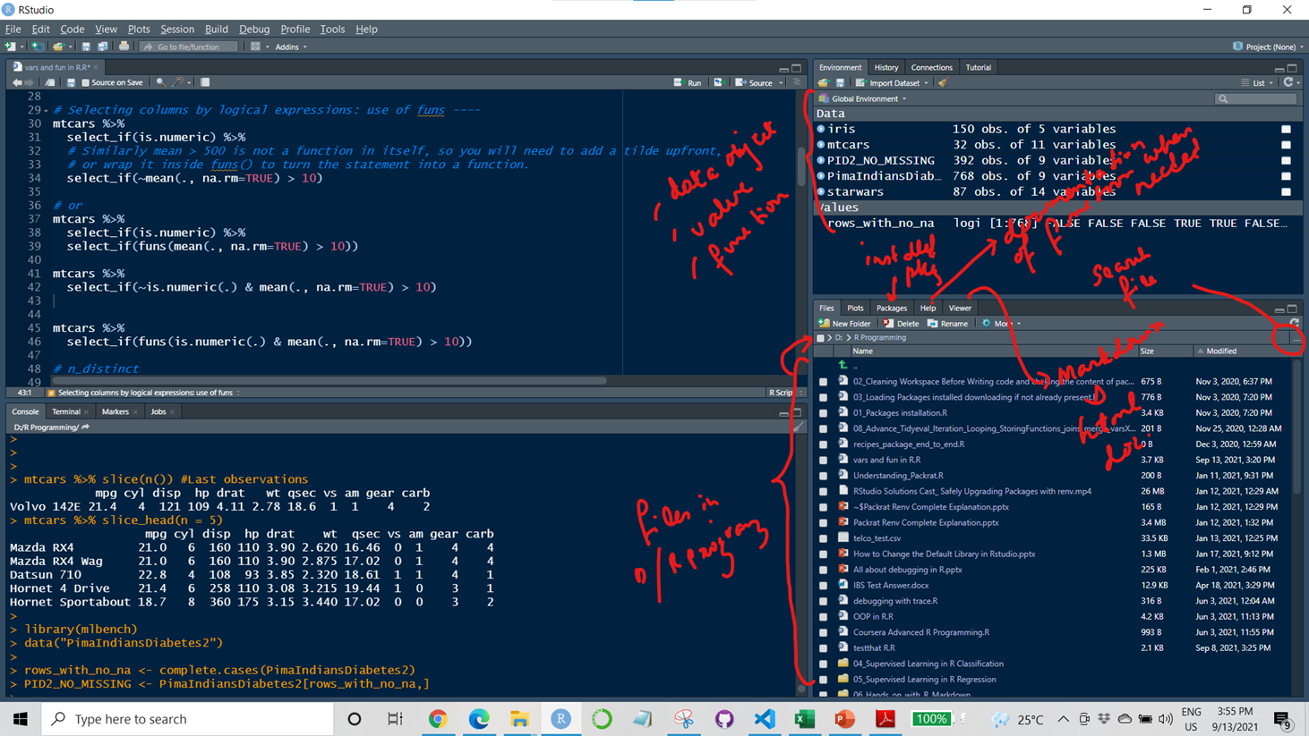
File Tab
Edit Tab
Code Tab
Environment, File/Plots/Pkg/Viewer

